Slide 1
SundAI Hackathon
Toby Sinkinsons

Slide 2
Edge AIML
EE
Power budgets
Sensor interfaces
Signal conditioning
In practice, domain knowledge can be critical:
Agriculture: Spectral signatures for nutrient deficiencies
Healthcare: Interpreting PPG/ECG waveforms
Aviation: Arc faults under extreme conditions (altitude, vibration, thermal)
Security: Network traffic patterns indicating attacks
Where hardware meets algorithms
AIML
Feature Extraction
Model architecture Training
Optimization
CS
Real-time systems Memory management Embedded software
Adapted from
Professor Song Han’s
MIT 6.5940 Course
Notes:
"Let me give you a sense of why domain knowledge matters. In aviation arc fault detection, you're dealing with 270 volts DC in a low-pressure environment—which makes ionization much easier. You've got vibration creating intermittent contact that looks like arcs but isn't. You've got temperature swings from 120°F on the tarmac in Phoenix to -40°F at cruise altitude. And you need 98% accuracy because a false positive grounds the aircraft, and a false negative causes an electrical fire.
No amount of AutoML can tell you that you need to collect data across that altitude-temperature-vibration envelope. That requires understanding the physics of electrical breakdown, cable degradation mechanisms, and flight profiles. This is what we mean by domain knowledge."

Slide 3
Why We Build Edge AIML Applications
Inference at the edge can happen in real-time
Training is often temporally and computationally intensive
Edge Models can be made to be small, efficient and customized for different architectures
Sending data to the cloud is cost prohibitive in terms of time, bandwidth, service cost
Inference data remains private
Many edge devices need to be small form factor and battery powered
Training
Intensive, slow,
off-device
Inference
Fast, local, real-time

Slide 4
The Industry Challenges
Source: Jeff Bier, "Key Challenges and Trends in Embedded Machine Perception,"
Embedded World North America, November 2025
© 2025 Edge AI and Vision Alliance. Used for educational purposes.

Slide 5
Three Broad Categories of Edge AI
Embedded Vision
Human Machine Interface
Sensor Analytics
Machine Vision
Medical Imaging
Surveillance Security
Keyword Spotting
Gesture Recognition
Telehealth
Predictive Maintenance
Safety Protocols
Factory
Industrial Robotics
Predictive Maintenance
Sprayers, Robotics
Navigation
Medical
Imaging
Monitoring
Building
Energy Management
Surveillance
Security
Power Tools
Anti-Kickback
Battery Authentication
Sports/Fitness
Activity/Vital Tracking
Training and Improvement
Agriculture

Slide 6
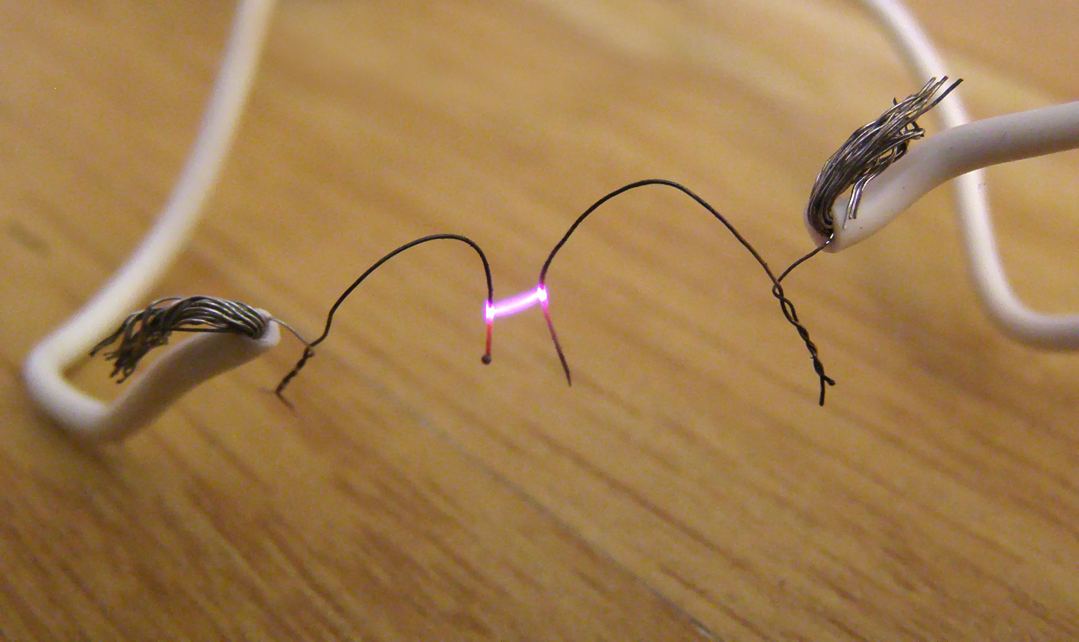
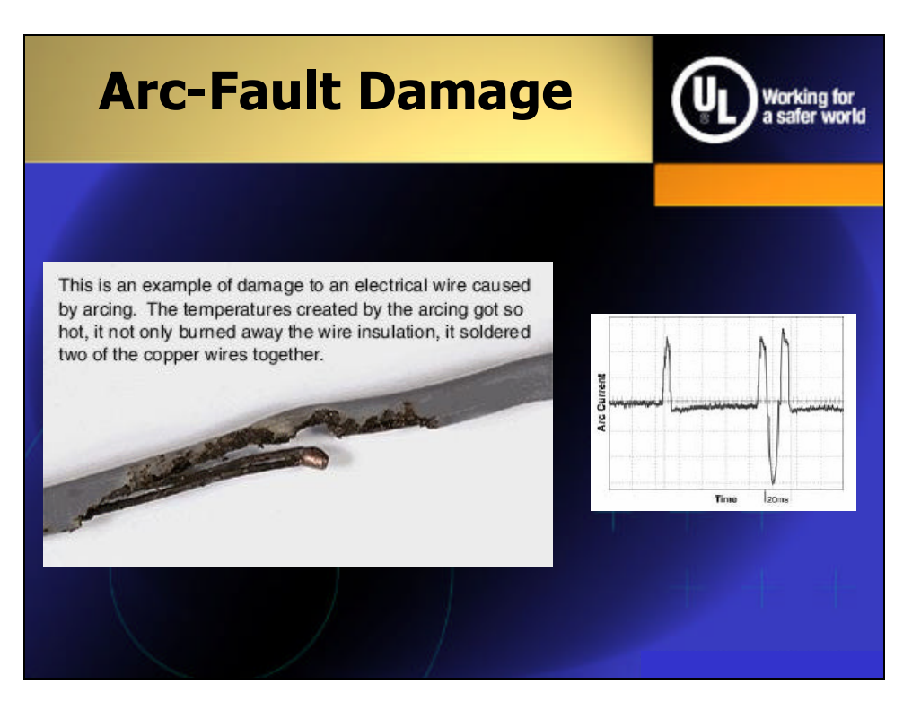
What is an Arc Fault
Unintended electrical discharge that jumps across a gap
Happens when damaged, degraded insulation creates a low impedance path that allows electrical current to arc through the air
Extremely high temperatures (exceeding 10,000° F) sufficient to ignite surrounding materials
Often in concealed locations: walls, attics, crawlspaces
Insulation damage can be from rodents, nail/screw penetration, natural aging, physical stress on wiring
AFCI’s were introduced in 1997 to mitigate these events
Rule based methods heavily bias towards not missing arc events
AIML helps reduce false positives from benign events

Slide 7

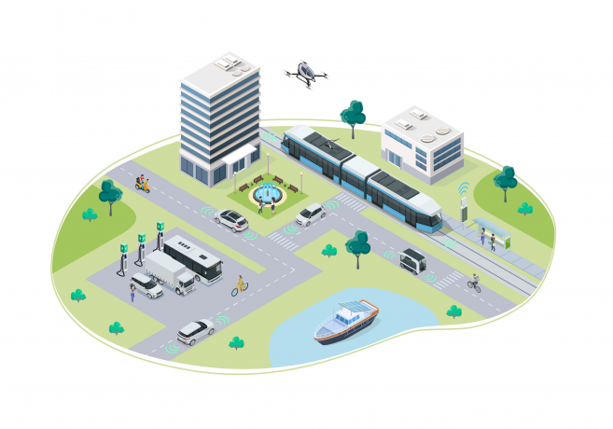
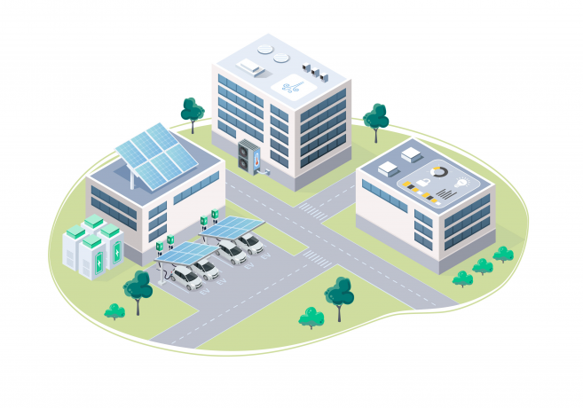

Applications for Arc Fault Detection
Energy Infra
Automotive
Solar PV Arrays
Smart Ignition Coils
Micro Inverter
Battery Disconnect Unit (BDU)
Smart Grid, Switch Gear
Energy Storage Systems
EV Chargers
Power Transmission
E Fuse, Fuse Box
DC Fast Chargers
Residential
Industrial
AFCI, Smart Breakers
Server Farms
Home Safety Systems
Charging Infra
Apartments, Malls
Heavy Load Equipment
Load Centers
Factory Power Systems
AC Arc
DC Arc

Slide 8

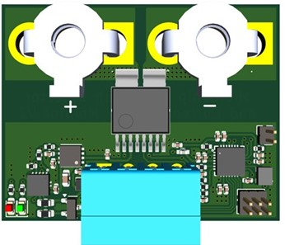

Arc Fault Detection
Training
M4F
AC
DC
AFD Device
Arc Simulator
Data Collection
Labelled data
Features
Model
C API
Arc signature
System signatures
Identifies best features and models, provides performance validation, testing, benchmarks and visualization
Knowledge Pack: Optimized, Device Specific Compilation
Deployment
AC
DC
M4F
Safety Critical
Save lives, prevent property damage
Arc Fault
AFD Device
Monitor
Classify
Benign Event
Operation Critical
Reduce system downtime

Slide 9
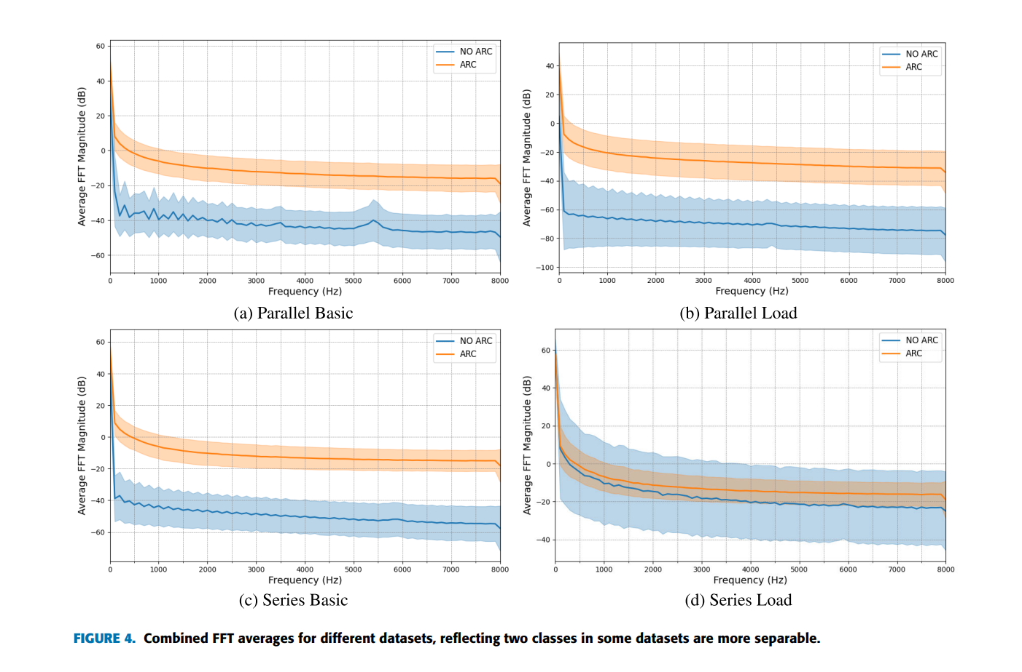
Why This Classification Is Hard
Source: Y. Mao et al., "Why AI: A Comparative Study for Detection Methods in DC Series Arc Fault,"
IEEE Transactions on Transportation Electrification, 2025. Figure 4.

Slide 10
Where Developers Struggle the Most
(Removed for brevity)
Hiring
Identifying product capabilities
Software integration
Training people
Hardware design
Identifying hardware platform
Other
Source: Jeff Bier, "Key Challenges and Trends in Embedded Machine Perception,"
Embedded World North America, November 2025
© 2025 Edge AI and Vision Alliance. Used for educational purposes.

Slide 11
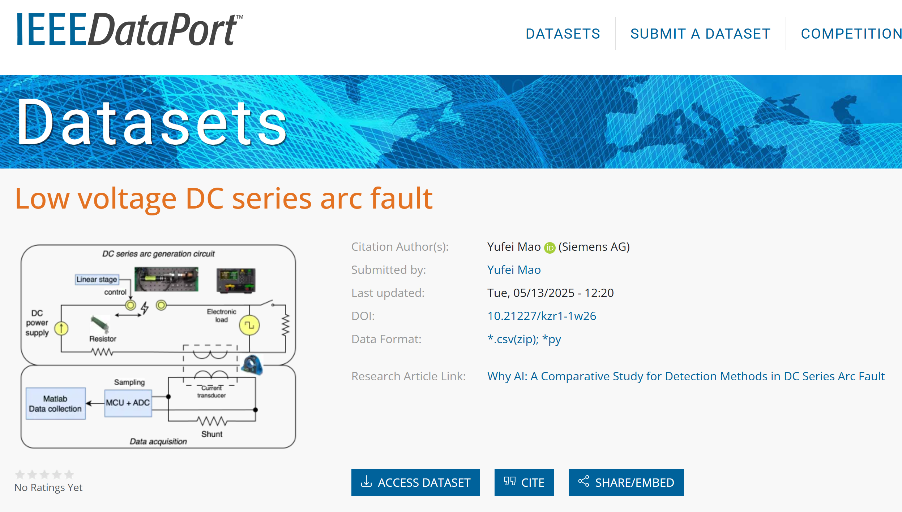
Dataset Sourcing
Study motivated to improve upon high false positive rate of rule-based methods
Notes:
AFD is one such example…
For our AFD baseline model, we found a public dataset from IEEE. Public datasets like these are very helpful proof of concept designs, however, they may not fit exactly the application you are interested in building. WE will look at the later in this training, but for now, I want to focus on the fact that this dataset was included with a research paper whose motivation was to show that ML models improved upon the high false positive rates observed with rule-based methods. So we have hit another piece of ML jargon, which we could skip over, however this is something that comes up often in Edge AI, so its worth taking a brief step back. For context… a false positive means, the system needs to shut down….etc… To understand how we evaluate false positives, engineers use a confusion matrix….

Slide 12
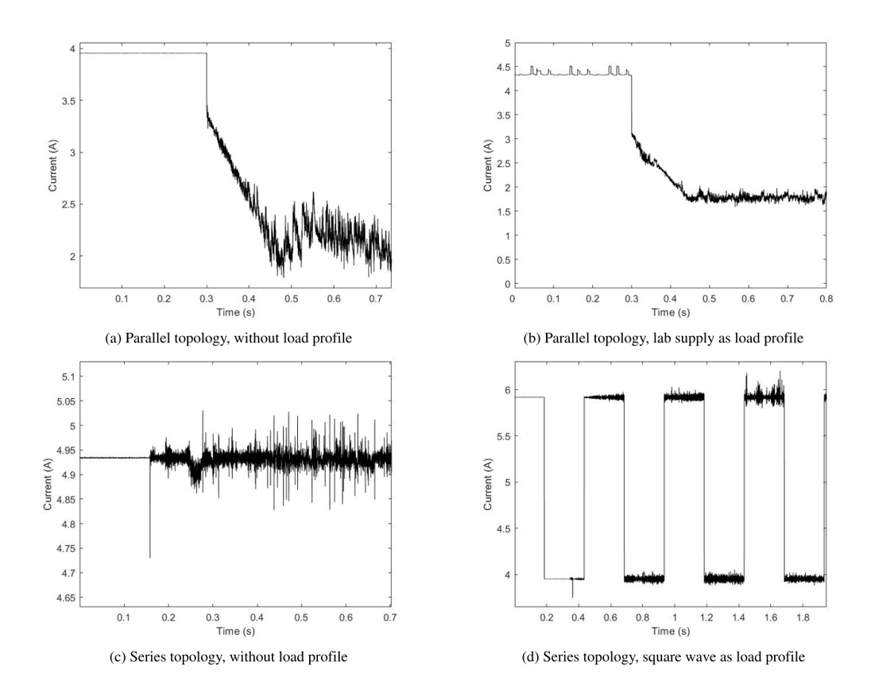


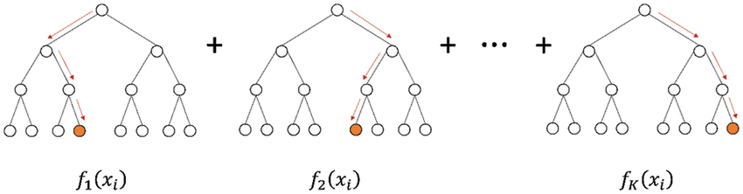
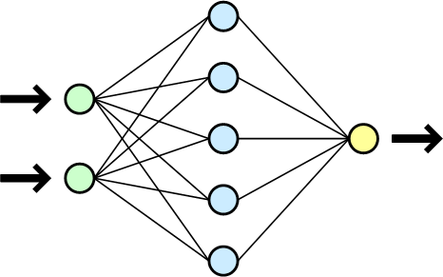
AutoML Generates Top Performing Models
IEEE Dataset
Knowledge Pack
Multiple diagnostic tools to evaluate performance
AutoML
Sequential time series data
Top Performing Models
Three models with the same accuracy but how did they differ in terms of memory footprint and latency?

Slide 13
Arc Fault Detection (3 Different Models)
Pattern Matching Engine
RBF/KNN Algorithm
Decision Tree Ensemble
XGBoost (max depth 2)
TFLite
Neural Network
Model Size: | 181 Bytes
SRAM: | 1456 Bytes
Flash Used: | 3591 Bytes
Latency: | 1.756 ms
Model Size: | 1142 Bytes
SRAM: | 1056 Bytes
Flash Used: | 3926 Bytes
Latency: | 1.584 ms
Model Size: | 11708 Bytes
SRAM: | 6304 Bytes
Flash Used: | 14292 Bytes
Latency: | 1.628 ms
4 Features:
3 Features:
2 Features:
Statistical: Absolute Mean
Statistical: Absolute Mean
Frequency: MFE
Frequency: MFE
Frequency: MFE
Statistical: Minimum
Statistical: Minimum
Statistical: Minimum
Time: PctTimeOverZero
Notes:
Looking left to right, we see the model size increases by an order of magnitude. Comparing SRAM….
So, we see how model selection impacts the memory and time, we need for inference. But two more things may jump out at you looking at these results. You may have heard Neural Nets are king, this doesn’t support that idea, we will talk about that in a moment, but first notice how each of these results show a different number of features. What are these and why are they important?

Slide 14
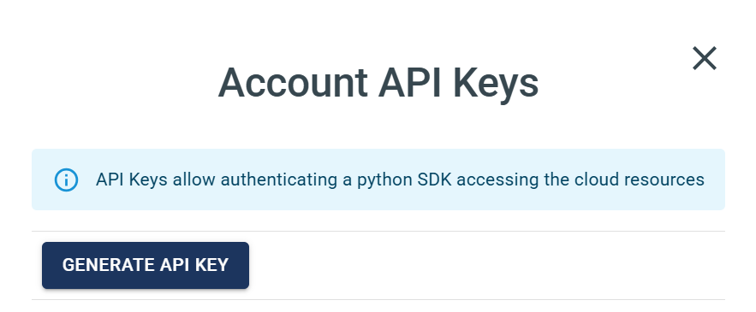
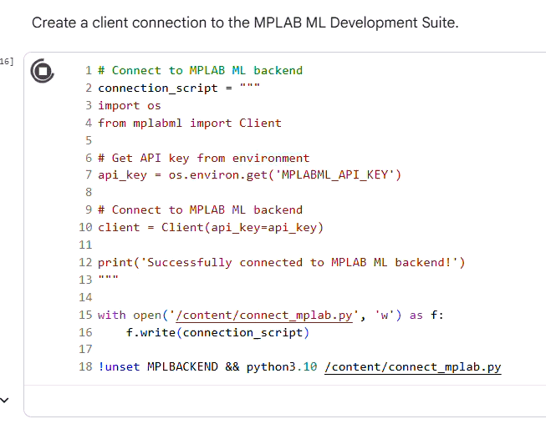
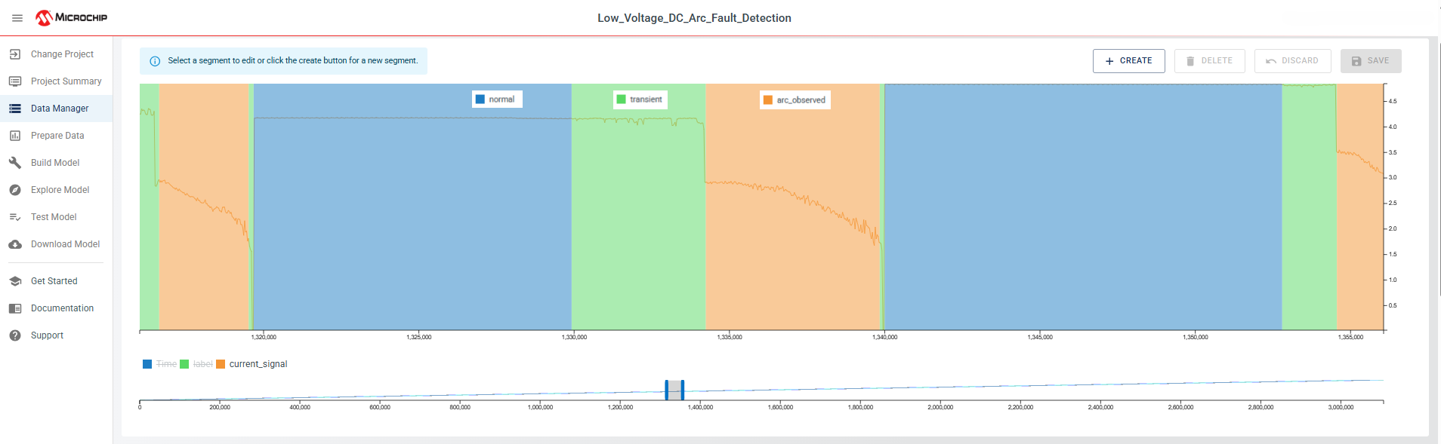
Dataset Annotation w/ MPLAB ML Python SDK
Connect to MPLAB ML backend and access methods from iPython
Easily generate API keys within the MPLAB ML
Auto-label and import data into projects

Slide 15


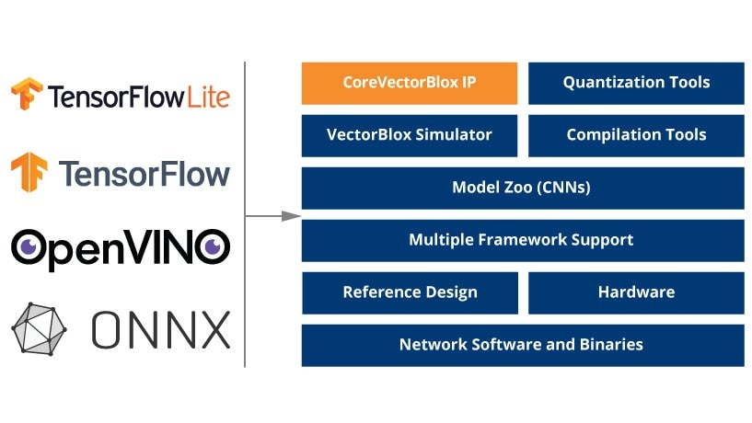



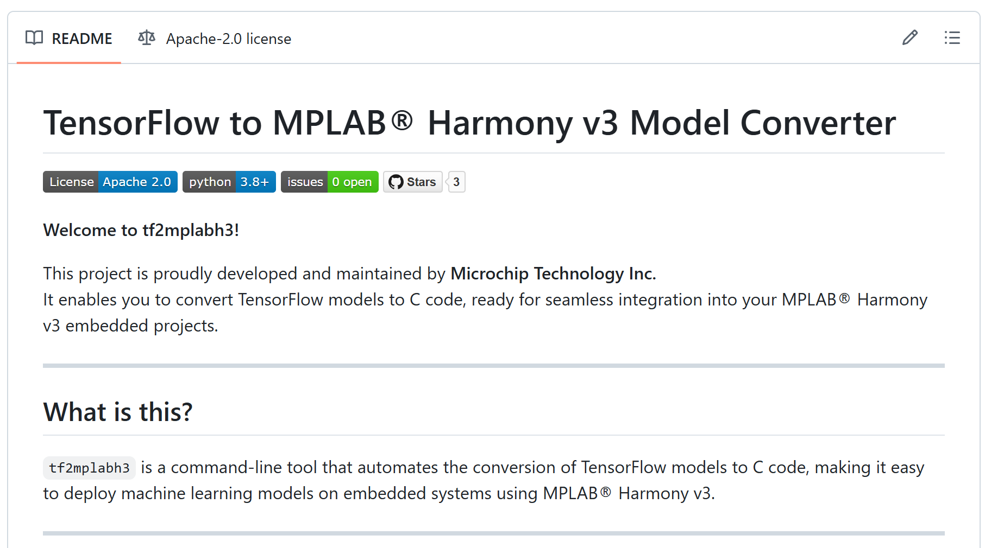
How Our Toolchain Helps
Entire ML pipeline to build models
AutoML for rapid development
Provides function calls:
3X - 6X Typical
Acceleration
AI on FPGAs
Innovative sparsity and
MAC pairing
Up to 80% power reduction
Supported by VectorBlox™
on Polarfire FPGA/SOC
kb_run_model()
Notes:
Has their own has their tools

Slide 16
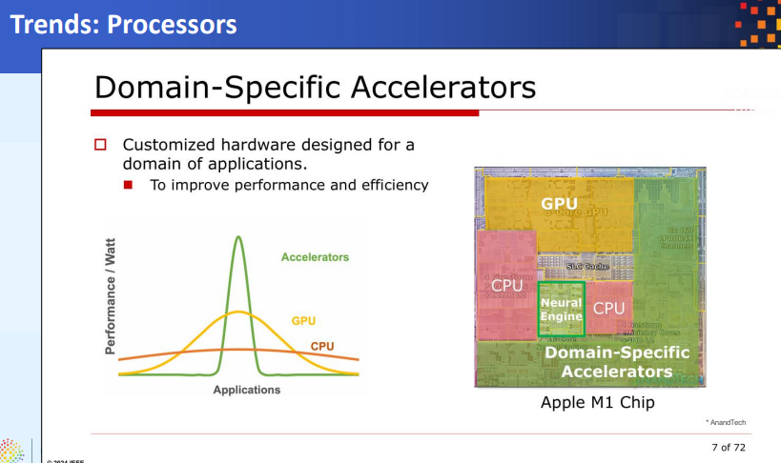
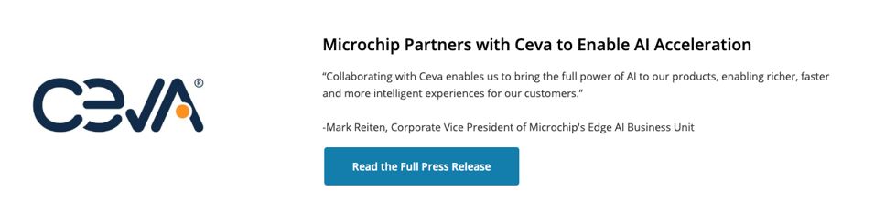
Where Industry Is Headed
NPUs becoming standard across SoCs for vision and multimodal workloads
Memory bandwidth > raw TOPS as the critical performance bottleneck
Multimodal models outperforming single-purpose models in some applications
Hybrid architectures are the most pragmatic solution

Slide 17
Hands-On Project Hardware
Circuit Python PyKit Explorer
Wand Gesture Recognition
Digital Nose

Slide 18
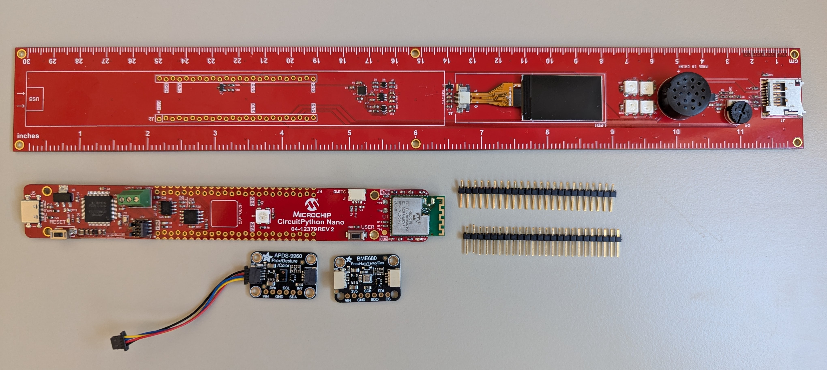
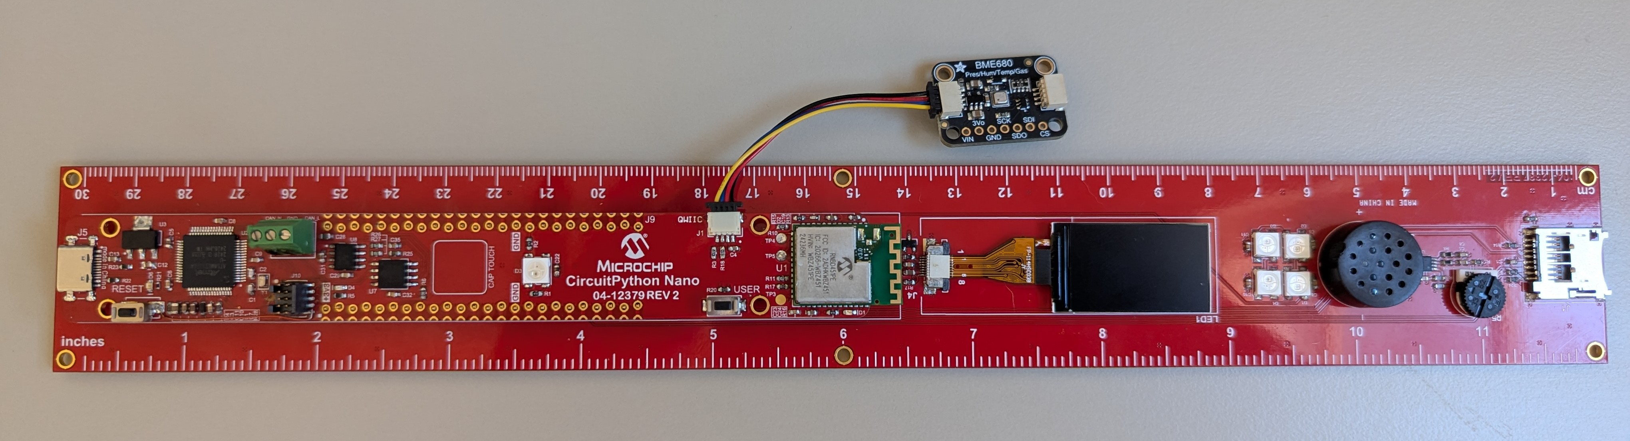
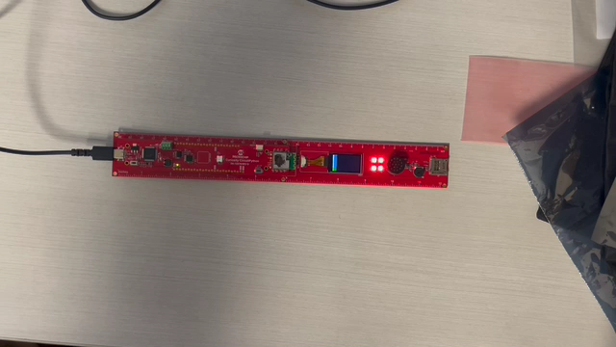
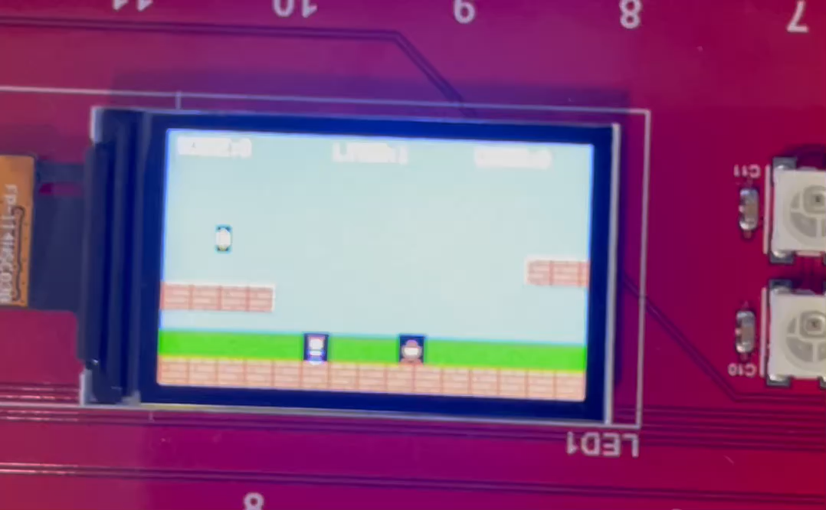
CircuitPython PyKit Explorer
Circuit Python eases the steep learning curve of learning embedded systems
Friction fit boards and Adafruit STEMMA connectors for I²C for solderless development
Workshop provides modules covering basic to advanced projects
Hackathon challenge: use vibe coding to expand and build more ambitious projects, like Snake or Super Mario Bros.

Slide 19
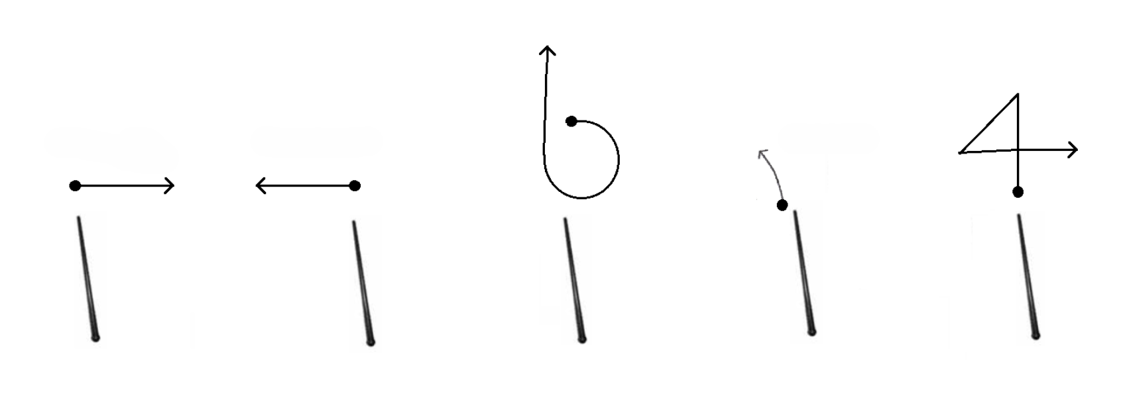
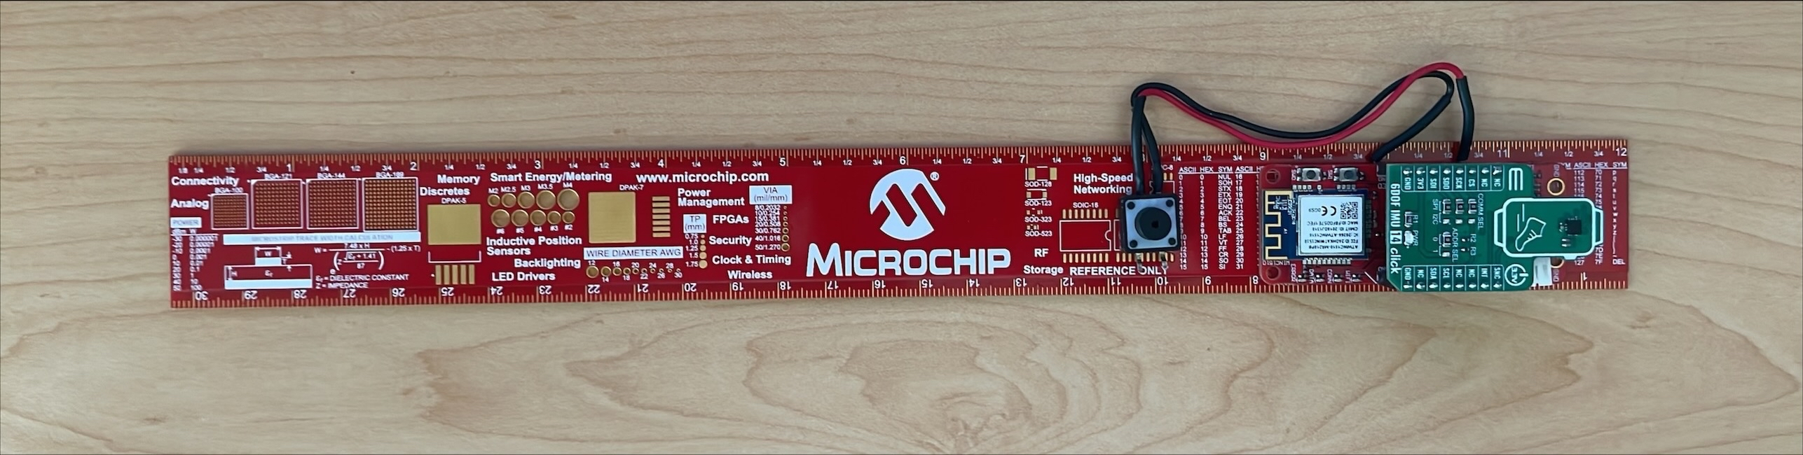
Magic Wand Gesture Recognition
Provide firsthand knowledge
Dataset curation challenges
Collect new gesture data to strengthen model
Import into model
Work with MPLAB ML SDK
Watch as the model improves throughout the day
Wand Gestures with MPLAB® Machine Learning Development Suite
Right
Left
b
Tap
4
ARM MC0+
SAMD21 Machine Learning
Eval Kit with TDK IMU
Button to simplify data collection
yet another ruler ☺

Slide 20
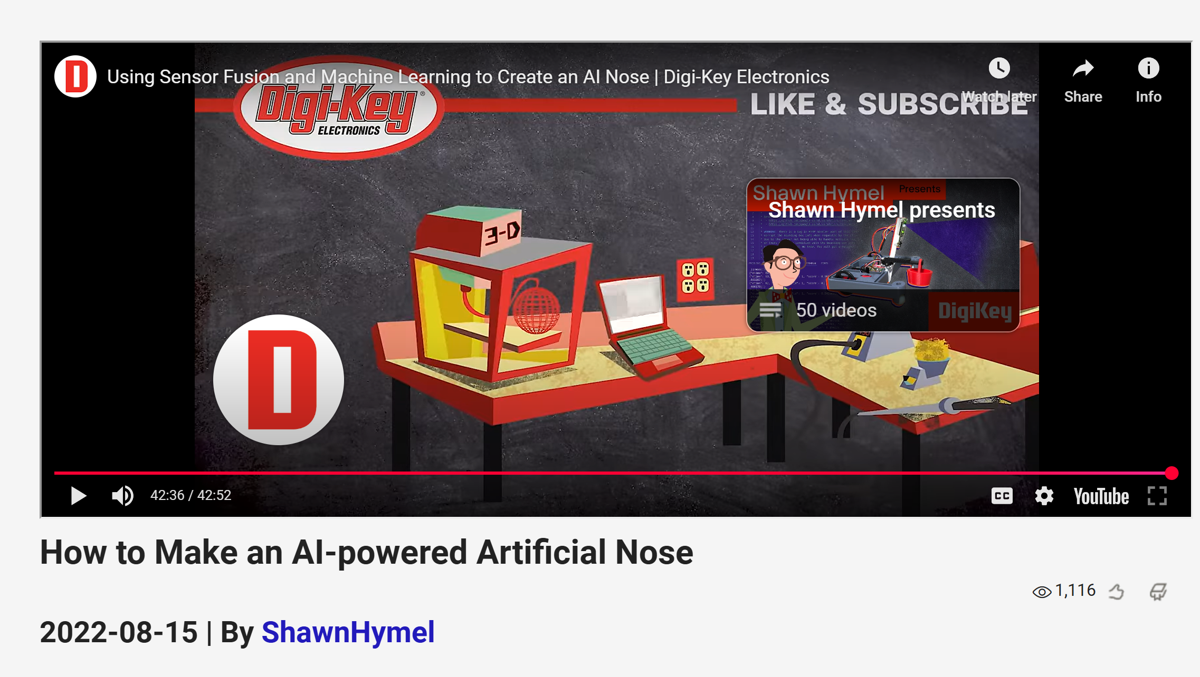
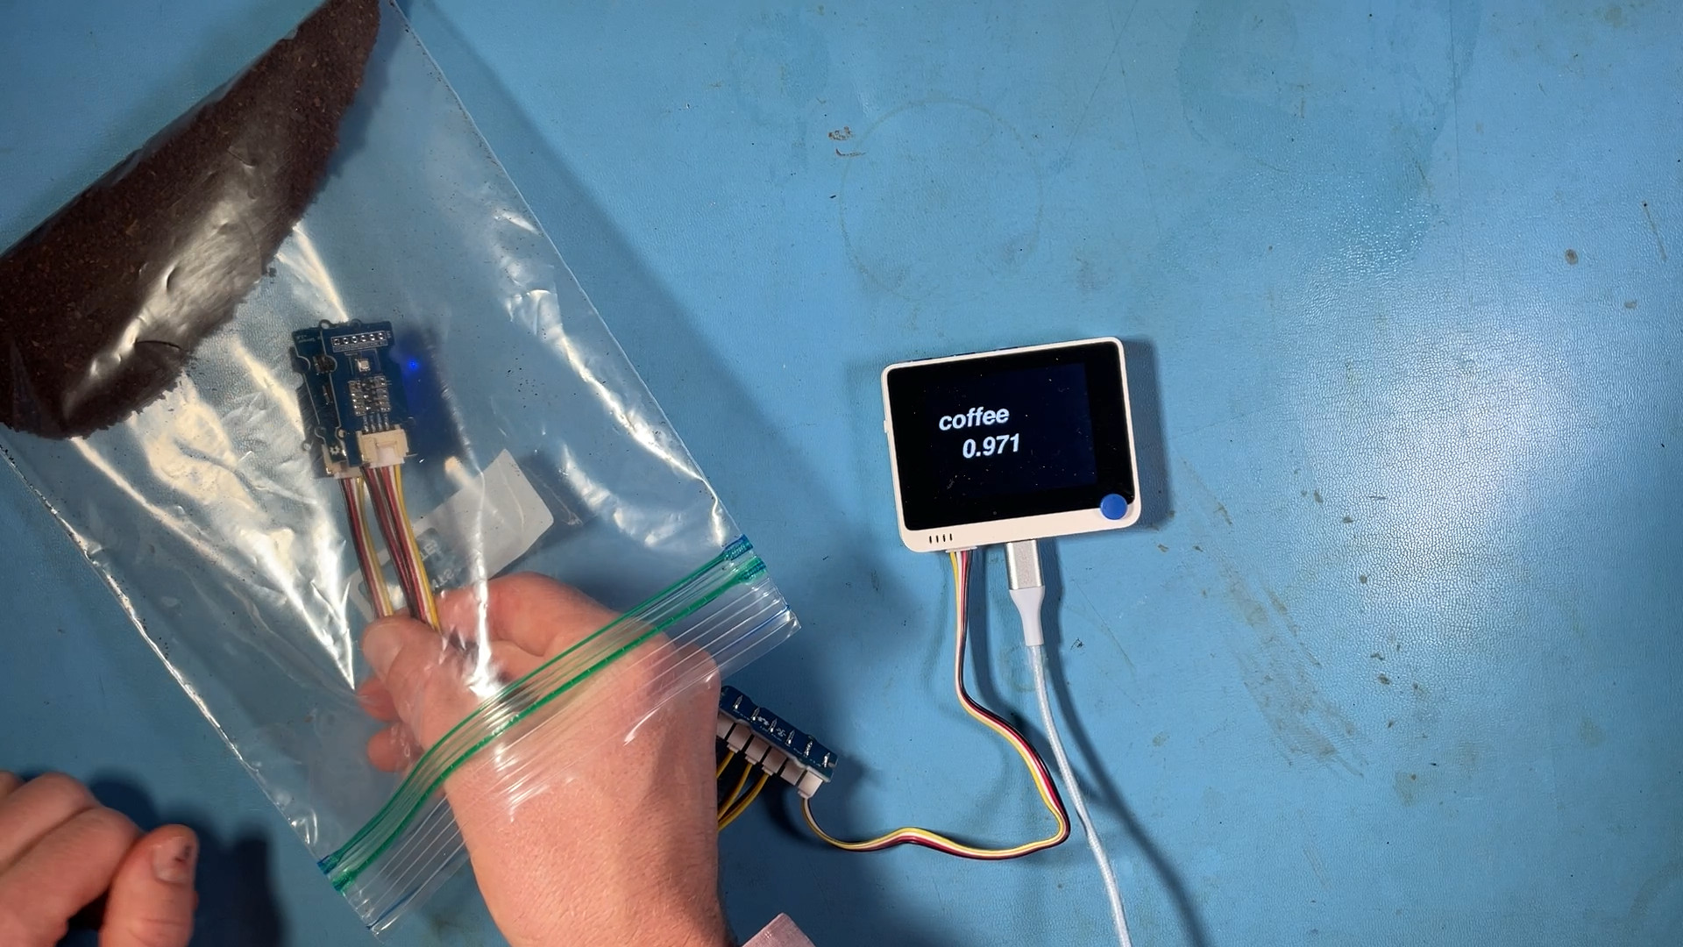
AI Digital Nose w/ Edge Impulse
Digital Nose Applications:
Chemical leak detection
Off brand cologne/perfume detection
Detecting food spoilage, contamination
Coffee roasting, wine, beer
Air quality monitoring
Basic odor classification using SAMD51 with Edge Impulse

Slide 21
Why Edge AI
Technical & Economic Drivers:
Bandwidth: Can't stream all sensor data to cloud
Latency: Real-time decisions need local processing (<100ms)
Economics: Cloud costs prohibitive at scale (millions of devices)
Reliability: Safety-critical systems can't depend on network
Privacy: Sensitive data must stay local
Edge AI enables systems that understand their environments

Slide 22
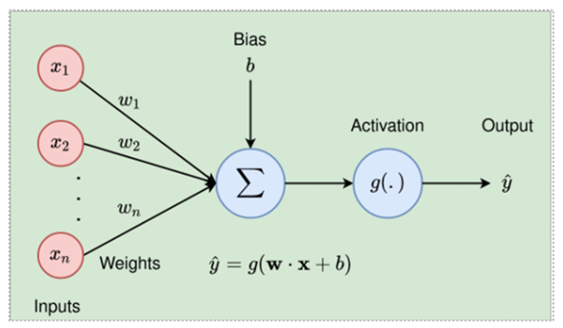

Neural Networks
Key ideas:
Neural Networks are trained by trial and error
This simple structure allows ML models to learn features empirically and generalize for cases never seen before
Large number of MAC operations now dominate system requirements and motivate optimization strategies
$$\hat{y}=g\left(w⋅x+b\right)$$
Single Neural Structure
Quantization
Pruning
Hardware Acceleration
Notes:
Neural structure is a fundamental unit of NNs, remarkably simple, all kinds of Learning can merge from this simple structure so it worth reflecting on it for moment. There are many resources in the wild to help you understand how this structure is used…
In comes n inputs of data….
Over many iterations (epochs) with labelled data, the weights ($w)$ are found which maximize prediction ($\hat{y}$) accuracy
When new unseen data ($x$) arrives, the model uses trained weights for inference

Slide 23
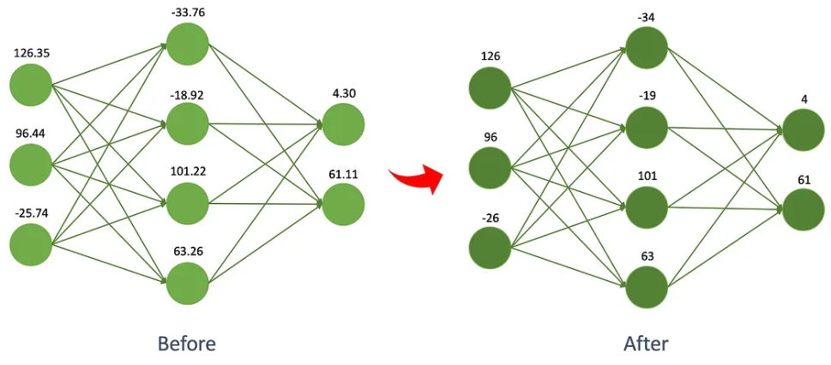
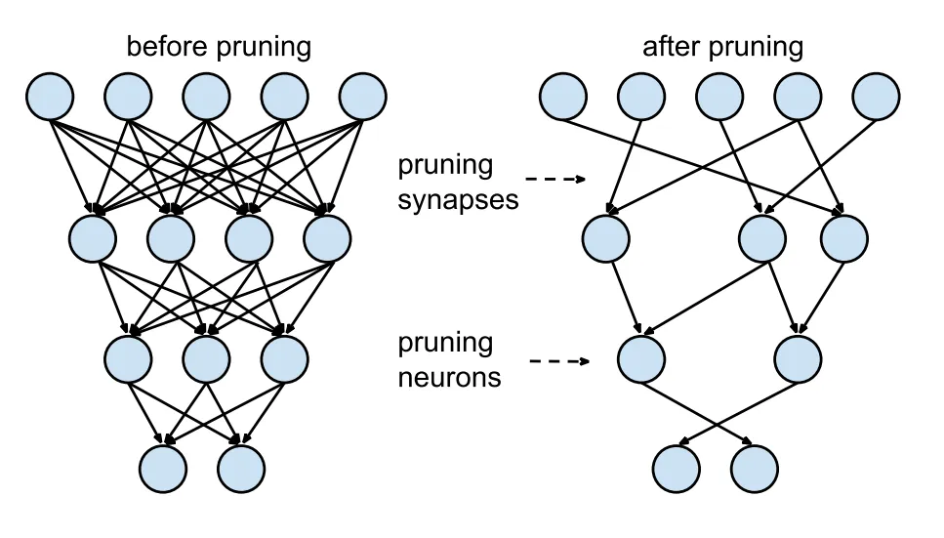
How Quantization and Sparsity Help
Every line represents a computation
Quantization = less bits needed to perform each computation
Sparsity = less computations per layer

Slide 24
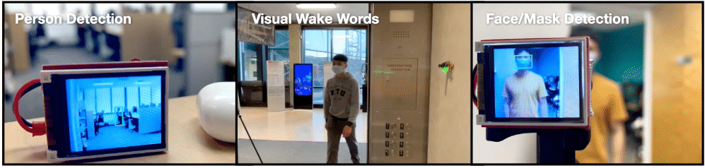
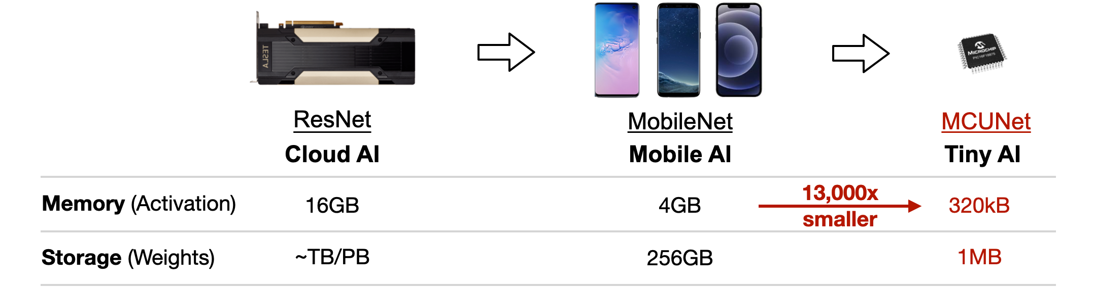
What Are Pre-Trained Models?
Open-Source Machine Learning Models
Trained by the community
Researchers and data scientists
Advantages:
Pre-trained models have already learned basic and object features
Provide a robust baseline
Trained and extensively tested on millions of images
Continually improved (open-source)
Specific applications can be rapidly developed through fine-tuning/transfer learning
Fine tuning works even with limited training data
Drawbacks:
Not optimized for specific hardware
Source: GitHub - mit-han-lab/mcunet: [NeurIPS 2020] MCUNet: Tiny Deep Learning on IoT Devices
Notes:
Key idea: transfer perquisite knowledge and only train for specific use cases: person detection using the camera in a factory setting….
A pretrained ML model can be used "as is", or can be retrained (fine-tuned), in order to make it more application-specific, therefore making it lighter, and quicker to run.

Slide 25
Remove These Slides Later

Slide 26

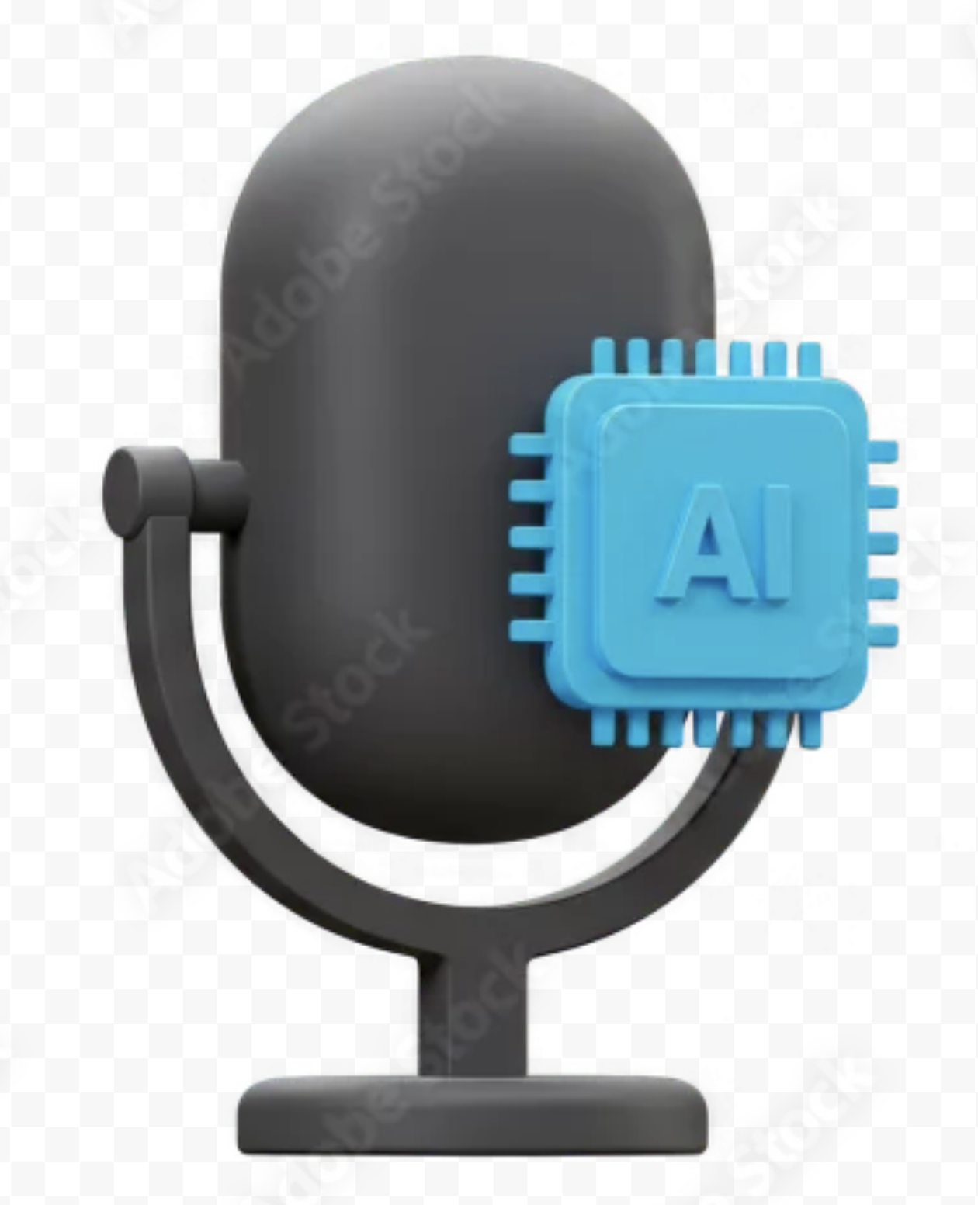

Keyword Spotting (KWS) Solution
Customize Wake/Command Words
Robust Noise Tolerance
AI Without Extra Acceleration Silicon
Easy To Use And Integrate
Accuracy:
~85–90%
Real-Time Response:
<700ms for end-to-end execution
Power Efficiency:
Listening Mode: ~1.2mA. Active Mode (Average): ~5mA
Memory Footprint:
~350 KB Flash <64 KB RAM
CPU Utilization:
~35 MIPS (~17% of dsPIC33A @ 200 MHz)
SNR
12dB

Slide 27
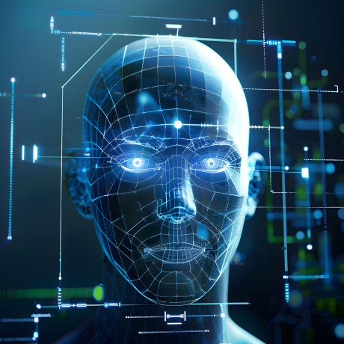
Face Identification
A production-ready application
Three Machine Learning Models:
Face Detection
Liveness Detection/Anti-spoofing
Face Recognition
Application running on a SAMA7 MPU
Support for Linux® and Bare-Metal Environments.
Models ready for a production use.
Easy-to-use API to customize a complete solution.
Target Metrics:
.
Reliability
Lighting and occlusion robustness
Pose Variation Tolerance
Security
Sensitive data encrypted
Secure Boot integration
Hardware cryptographic features
Bill of Materials
Anti-spoofing feature relies on a single RGB video stream, opening the door to entry-level CMOS Sensors/USB Cameras.
Entry-level display support on the SAMA7D65 (LVDS/MIPI-DSI® Interfaces)
Liveness Detection |  |  | Face Recognition |  |  | End to End
F1-Score | FAR | FRR | Matching Accuracy | TAR | FAR | Latency
95% | 0.1% | 5% | 98% | 95% | 0.1% | 350 ms
*FAR=False Acceptance Rate, FRR=False Rejection Rate, TAR=True Acceptance Rate
Notes:
https://marcom.microchip.com?open=e02386c8-a65e-11ef-a7d3-005056a216eb (395028 / AdobeStock_807352032.jpeg)
False Acceptance Rate

Slide 28
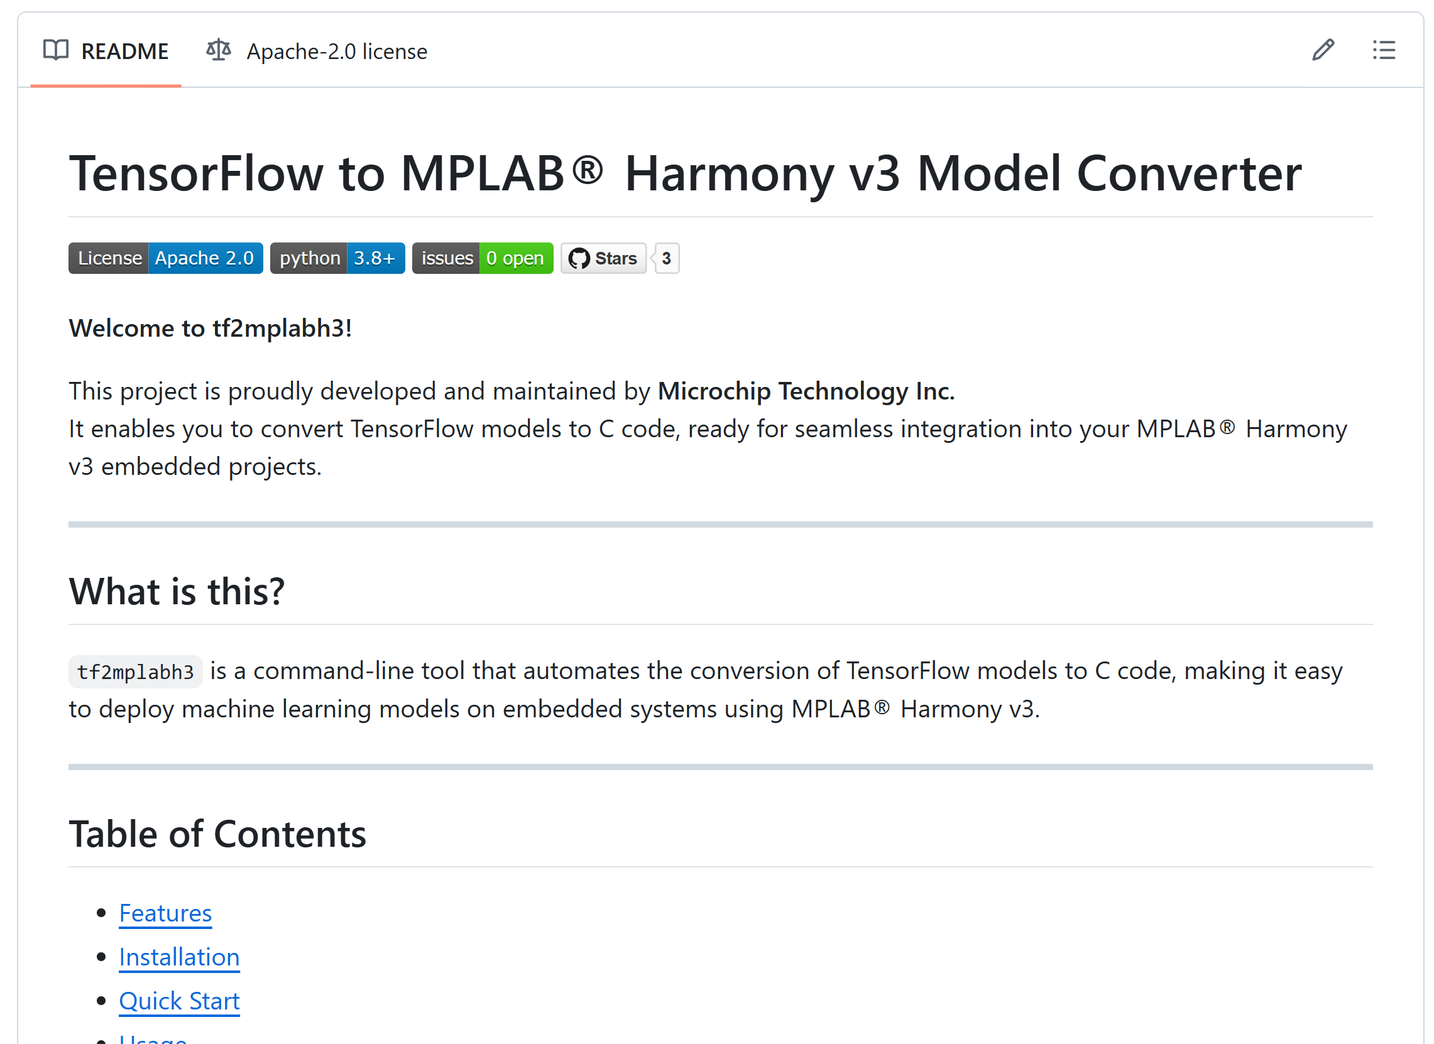
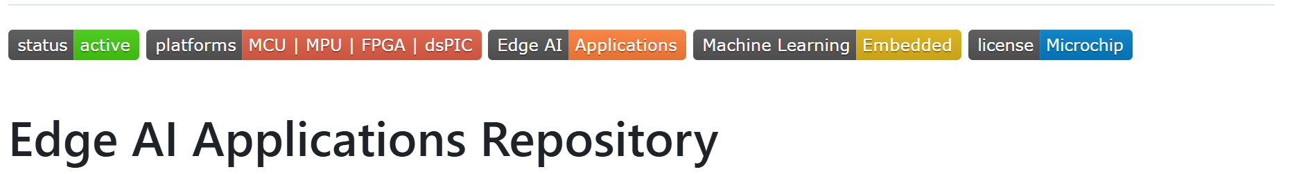
Convert TensorFlow Models to C code
Easy CLI interface
Verbosity control for logging
Support for int8 quantization on the fly
Ready for integration with MPLAB Harmony v3

Slide 29
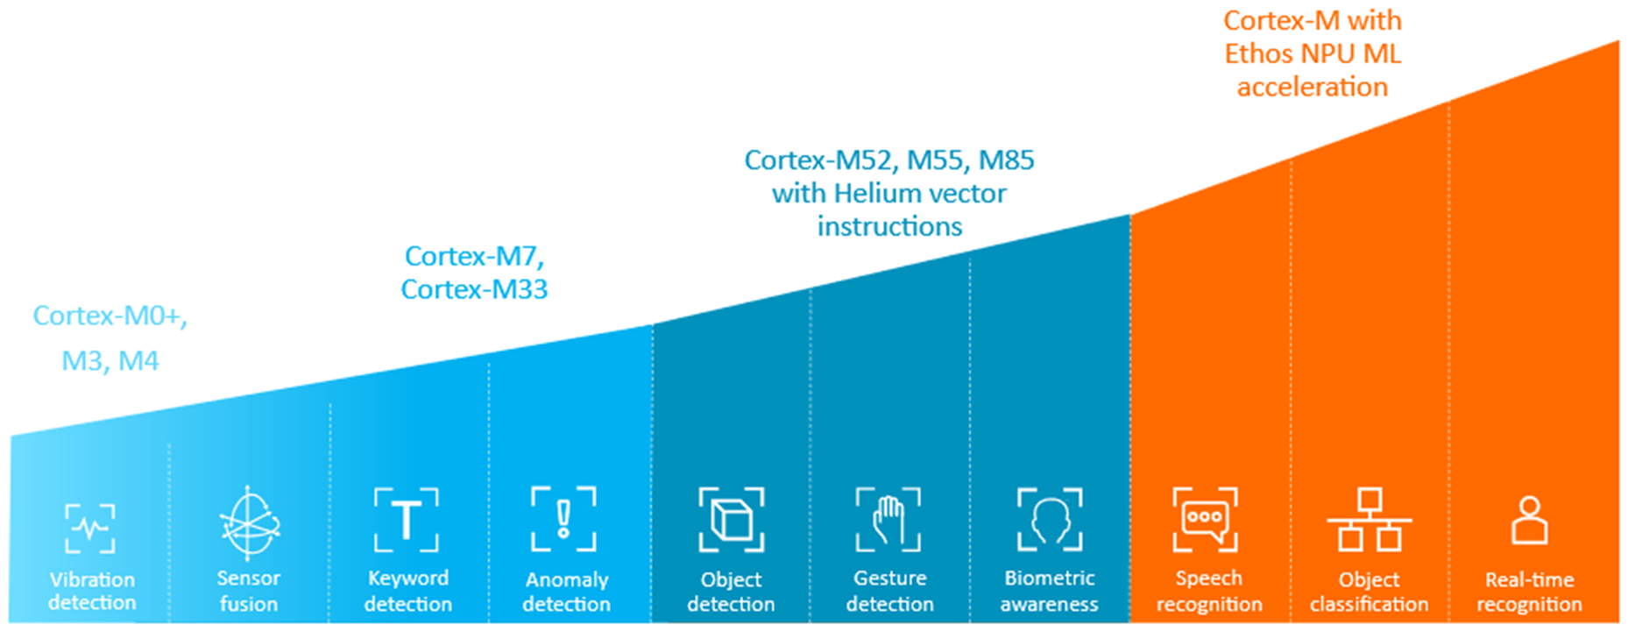
Cortex-M ML Applications According to ARM
Notes:
General landscape, Generic chart, various techniques to compress, maybe create another one for this
Nou generic guidance, simple landscape…starting point
Continuum of applications, some are more difficult than others Take Away -> Bring in the expert, let’s us help you find ( come out at beginning or the end)

Slide 30
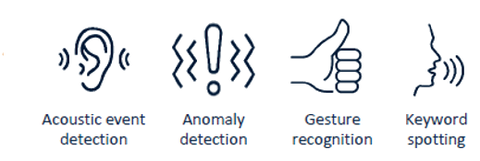
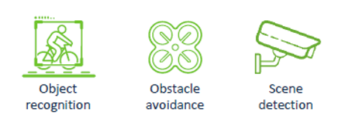
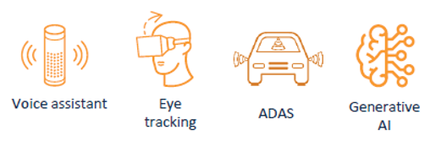
Performance Curve for Various Applications
0.2 TOPS
0.2 – 4 TOPS
4-200 TOPS
32-128 MACs
200K-1M SRAM
256-1024 MACs
500K-4M SRAM
100M-1G DRAM
4K-32K MACs
500K-4M SRAM
1G-4G DRAM

Slide 31
Common Edge AI Algorithms
Model Type | Description | Edge AI Suitability
Decision Trees | Simple, interpretable models for classification tasks (e.g., detecting faults in machinery) | Lightweight, ideal for MCUs
Random Forests | Ensembles of decision trees, improving accuracy for tasks like sensor data analysis | Better accuracy, still feasible on MCUs
CNNs | Optimized for image tasks like object detection in smart cameras | NPUs accelerate them efficiently
RNNs | Used for sequential data like time-series sensor readings | Less common on edge due to complexity
Transformers (SLMs/VLMs) | SLMs like MobileBERT (~25M params, ~50MB) VLMs like MobileCLIP (~100M params, ~200MB) good for voice or image + text tasks | Requires memory optimization (quantization/pruning)
TinyML | Framework for ultra-efficient models (quantized). | Designed specifically for MCUs
Notes:
We can have hunches about which models will work best, but often we need to test

Slide 32
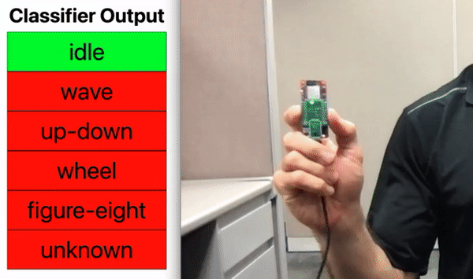
Understanding Dataset Requirements
Sufficient data to generalize to unseen scenarios
Potential Bottlenecks:
Data can be difficult or impossible to acquire, ex. motorcycle airbag deployment
Data that meets requirements for certification can be expensive
Public datasets may not cover sufficient use cases
Synthetic data may fill gaps
Notes:
Advantage of Edge AI systems, infer with the same data.

Slide 33
Encoded Assumptions in a Dataset
Word | Utterances
Up | 3723
Down | 3917
Left | 3801
Right | 3778
Stop | 3872
Go | 4044
On | 3845
Off | 3745
… | …
Unknown | 28375
Google’s 35 Keyword Commands Dataset
In real world deployment, keyword spotting systems mostly hear non-command speech
For each of the 35 keyword classes in the set
The model is trained with ~4000 examples
Unknown class contains 28,375 examples
Includes noise, non-command words
7:1 imbalance mirrors real-world conditions
Prevents models from being too eager to classify commands not in the set as one of the target keywords
Requires higher confidence to classify one of the target keywords

Slide 34
Where are the bottlenecks and opportunities?
Awareness
Feasibility
Development
Deployment
Scale
Unaware of Edge AI capabilities
Early R&D stalled, engineering time and effort too large
Wants AIML, but doesn’t want to develop it
Needs help moving to production
Wants to integrate deployed Edge AI products into a larger system
Might not see market value yet
Wants to be able to update models after they have been deployed
Wants to streamline engineering pipeline for future products
Needs proof of concept to get green light
Has strong domain knowledge, wants a tool that is easy to use
Has challenging application idea, not even sure it can be done
Needs to develop non-camera pose estimation for privacy reasons
Is a low-cost sensor good enough?
Notes:
Ultimately, all customers want to move to the right here, at systems level we need to have designs, tools and partners that help customers move efficiently along this path.

Slide 35
MPLAB ML Development Suite
Models
Hierarchical Clustering with Neuron Optimization
PME (Pattern Matching Engine)
TensorFlow Lite for Microcontrollers
Neuron Optimization (KNN/RBF)
Bonsai Tree Optimizer
Fully Connected Neural Network
XGBoost (Extreme Gradient Boosted Trees)
RBF with Neuron Allocation Limit
Random Forest
RBF with Neuron Allocation Optimization

Slide 36
OpenMV
Exploring vision on microcontrollers
Originally, at Carnegie Mellon 20 MIPS of performance
Started on STM32 board after school
The game has changed since they began
Power on instantly, power-off instantly
Pilots usually begin with NVIDA, $150 per cable, all the best high-end equipment. Does not scale, customer will not go beyond pilot stage.
Stuck in high value verticals, but employ vision for stupid simple tasks
Light switch that can identify people walk in front of it
Locally, means you need performance (NPU), and battery powered
Even beyond cost for high end pilot, you still need power
AI on board, prices that are scalable
Int8 quantized

Slide 37
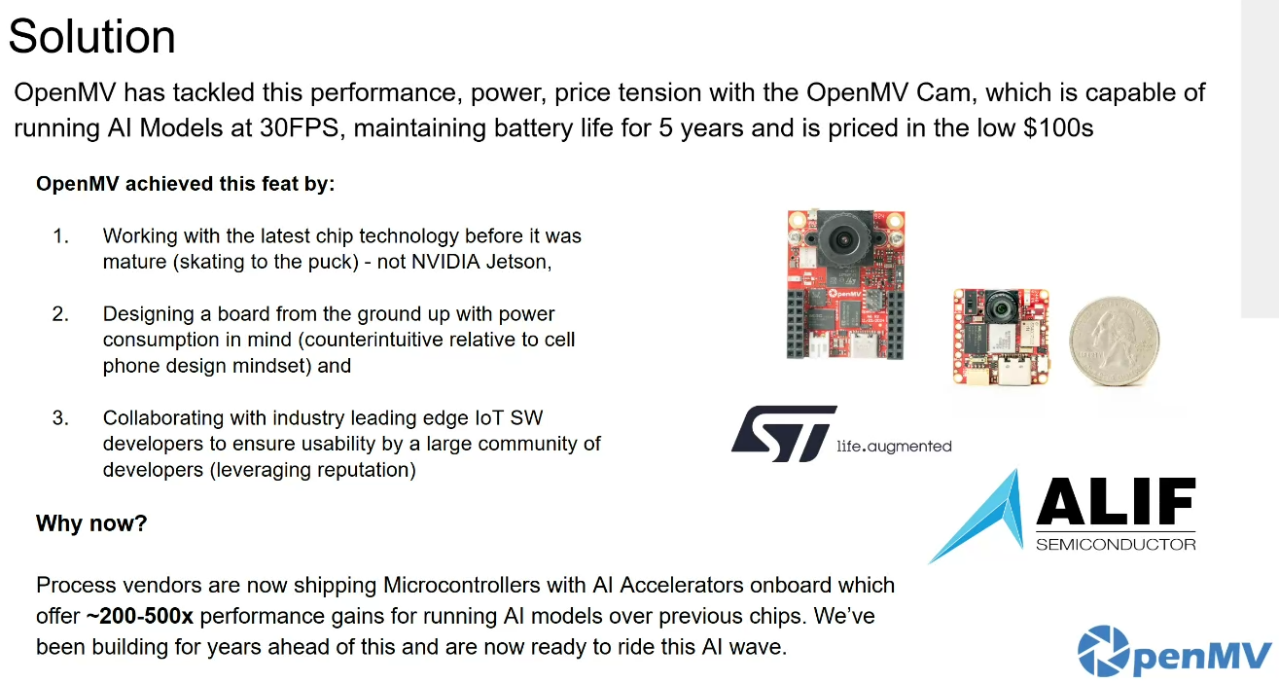
Person Detection 30FPS, battery 5 years

Slide 38
Typical PV AFD Data Collection Sequence
5 - 10 sec
1
2
3
4
5
6
dsPIC33A Bootup
Continuous Sampling
Outputs ADC readings
12 Mbaud UART
Python Script: Buffers and writes to file
Prvides
live plot of input
Inject small current 1 A for safety purposes
Measure ADC for reference check if baud works
Reprogram with capture firmware
Start arc simulation
Inverter protection kicks in
Stop arc simulation
to protect arc generator
Python Script
exports to
csv file
Files can be very large
Auto label and import into
MPLAB ML project
Optimal data collection depends on:
Time of Year
Time of Day
Weather Factors

